Slide 1
Creating Graphics - part 1
A Cross-curricular project for Fine Arts

Slide 2
Warm-up
Simple images using shapes

Slide 3



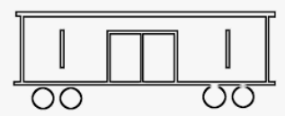
Simple drawings
What images can you draw with just circles, rectangles and lines?
A face?
A house?
A car?
A flower?
???

Slide 4
Activity #1
Design a simple graphic

Slide 5
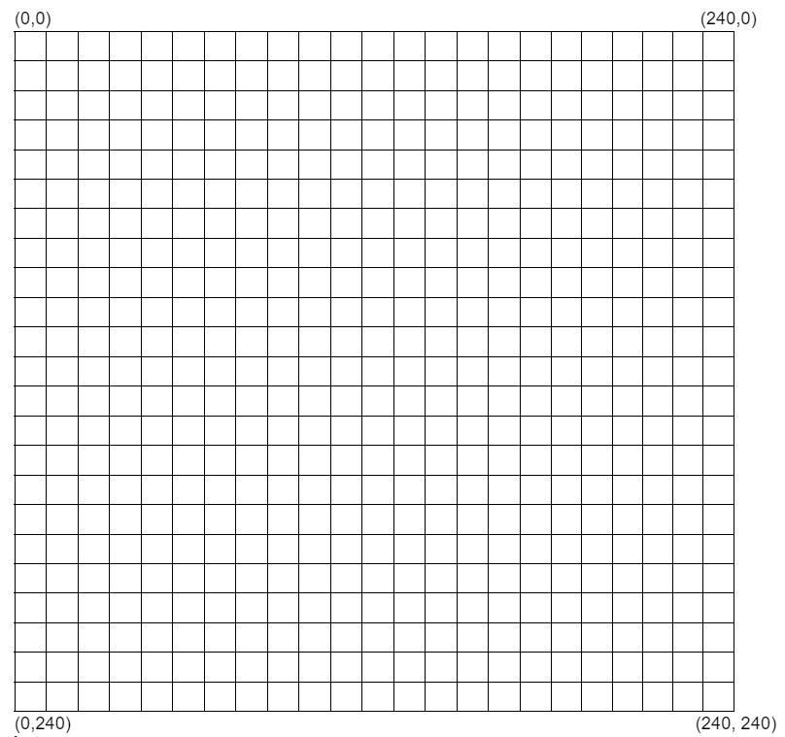
The CodeX screen
origin
x
The CodeX has a 240x240 color LED display. You can use simple graphics to create your own images. Think of the screen as one quadrant on a graph.
The origin is in the upper left corner
The x values go across, to the right
The y values go down, to the bottom
All x and y values are positive
y

Slide 6
Creating Graphics
Use these commands to draw shapes. x and y represent the position on the graph (liked an ordered pair).
display.draw_circle(x, y, radius, color)
display.fill_circle(x, y, radius, color)
display.draw_rect(x, y, width, height, color)
display.fill_rect(x, y, width, height, color)
display.draw_line(x1, y1, x2, y2, color)
display.draw_text(“text”, scale, color, x, y)

Slide 7
The CodeX screen
B
A
Write down the code for these shapes:
C
D

Slide 8
The CodeX screen
B
A
fill_rect(20, 10, 40, 70, RED)
draw_circle(120, 30, 10, YELLOW)
draw_line(90, 60, 160, 120, BLACK)
fill_rect(30, 180, 150, 50, BLUE)
C
D

Slide 9
The CodeX screen
Try drawing some of your own shapes, and write the code for each shape.

Slide 10
Activity #2
Design your own image

Slide 11
Creating an image
Using the graph paper if needed, design a simple image. It can be anything appropriate that uses circles, rectangle and lines.
Keep the image very small and simple
Start the image in the upper left hand corner
You can use the one provided if you have a hard time thinking of one

Slide 12
Creating an image
Write down the code for each shape
Include draw or fill
Include the x and y start location
Include the radius or width and height
Include the color
Refer to the next slide if you need a reminder of the Python colors

Slide 13
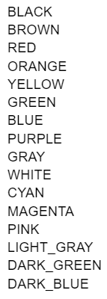
Built-in Python colors
You can always use a custom color if you know the RGB values
For a custom color, use:
  color = (R#, G#, B#)

Slide 14
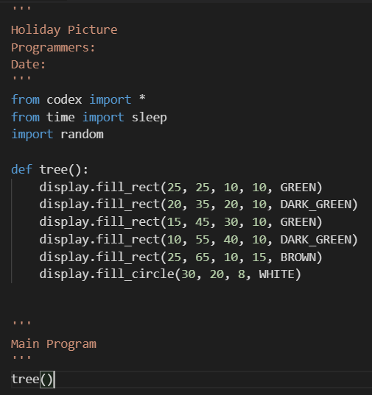
Creating an image
Start a new program
  Add a comment block at the top
  Import codex, sleep and random
Create a function for the image
Call the function. Do you see your image?
Modify the code until you have the image just the way you want it.

